Slide 1
Java.lang.package

Slide 2
What is objects class?

Slide 3
For any java object whether it is predefine or customized the most commonly required methods are encapsulated into a separate class which is nothing but object class.

Slide 4
Method present in objects class?

Slide 5
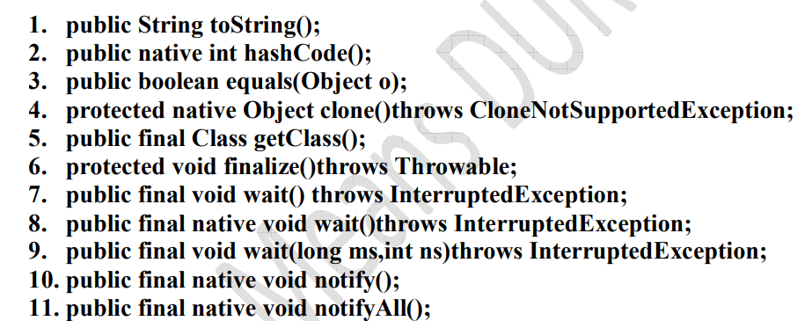

Slide 6
Public string toString()
1. We can use this method to get string representation of an object.
2. Whenever we are try to print any object reference internally toString() method will be executed

Slide 7
1. We can use this method to get string representation of an object.
2. Whenever we are try to print any object reference internally toString() method will be executed

Slide 8
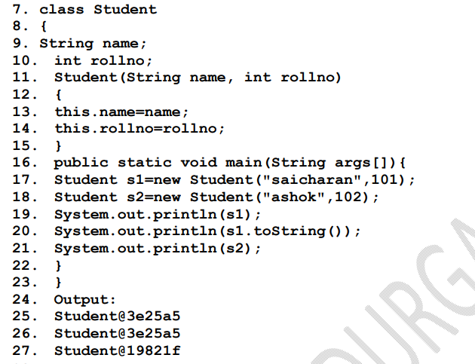

Slide 9
Public native int hashCode()

Slide 10
1. For every object jvm will generate a unique number which is nothing but hashCode.
2. Jvm will using hashCode while saving objects into hashing related data structures like HashSet, HashMap, and Hashtable etc.
3. If the objects are stored according to hashCode searching will become very efficient (The most powerful search algorithm is hashing which will work based on hashCode).

Slide 11
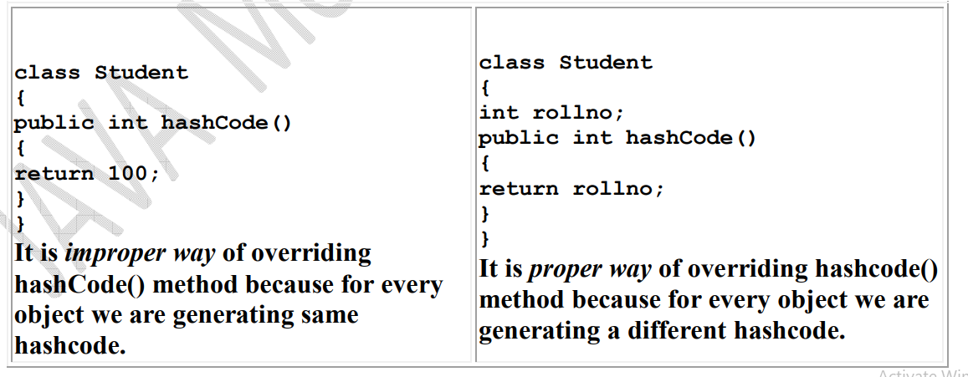

Slide 12
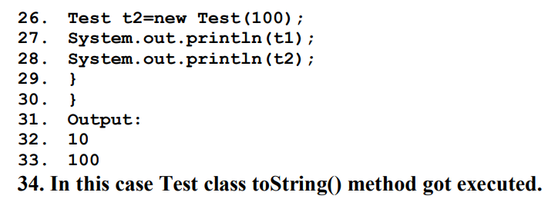
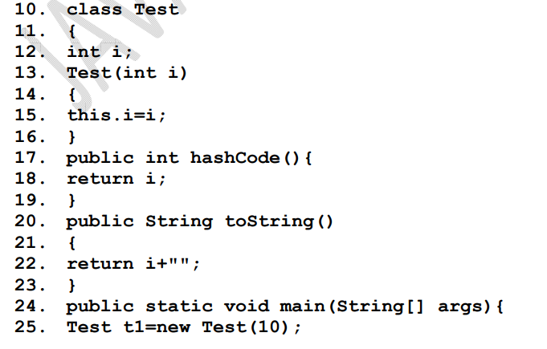

Slide 13
equals() method:

Slide 14
1. We can use this method to check equivalence of two objects.
2. If our class doesn't contain .equals() method then object class .equals() method will be executed which is always meant for reference comparison[address comparison].
i.e., if two references pointing to the same object then only .equals( ) method returns true .

Slide 15
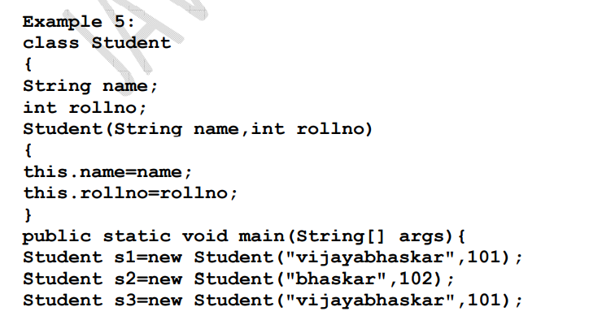
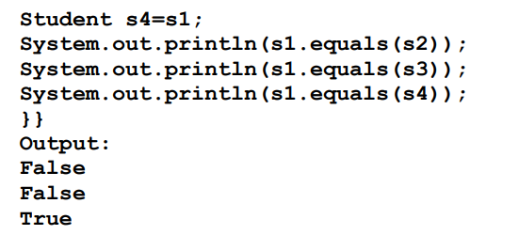

Slide 16
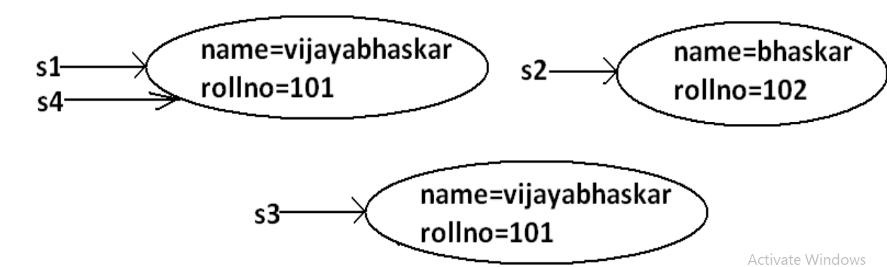

Slide 17
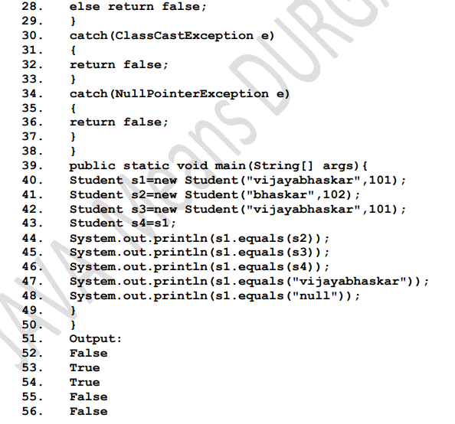
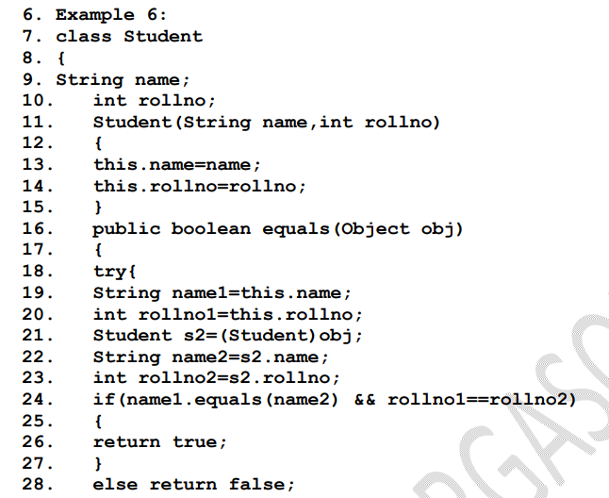

Slide 18
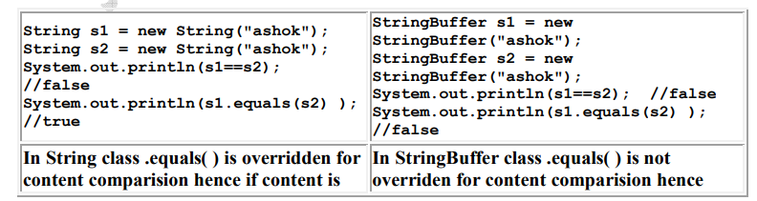

Slide 20
Differences between == (double equal operator) and .equals() method?

Slide 21
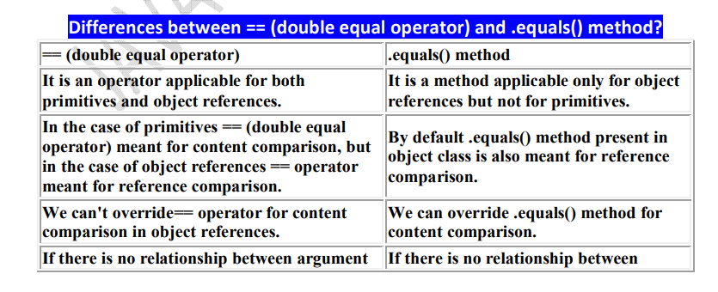

Slide 22
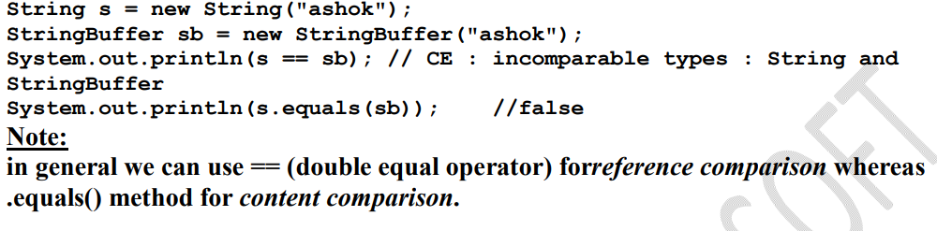

Slide 23
Clone () method:

Slide 24
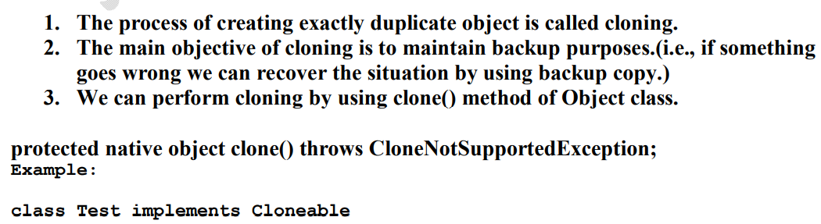

Slide 25
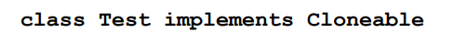
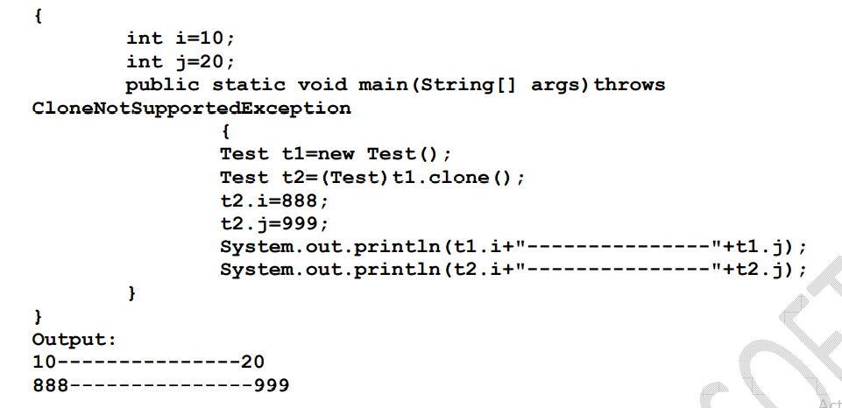

Slide 26
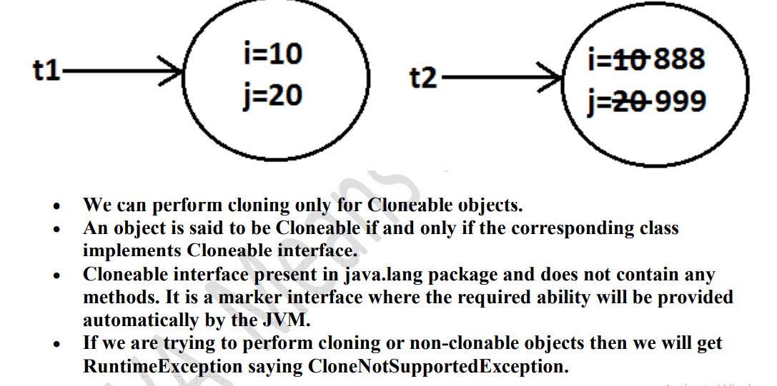

Slide 27
Shallow cloning

Slide 28
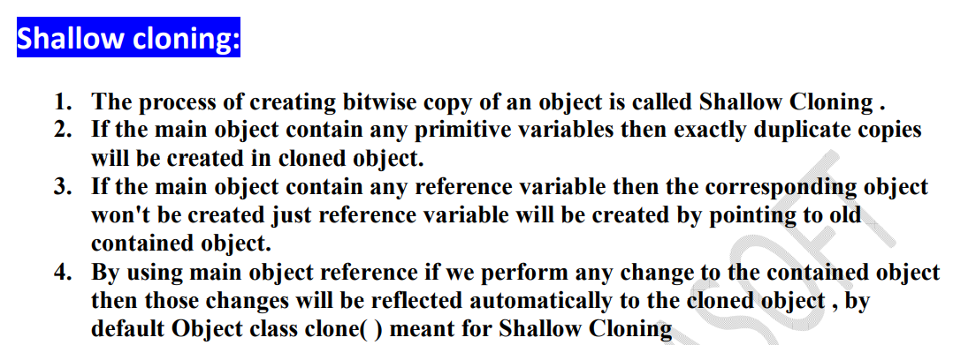

Slide 29
Deep cloning

Slide 30
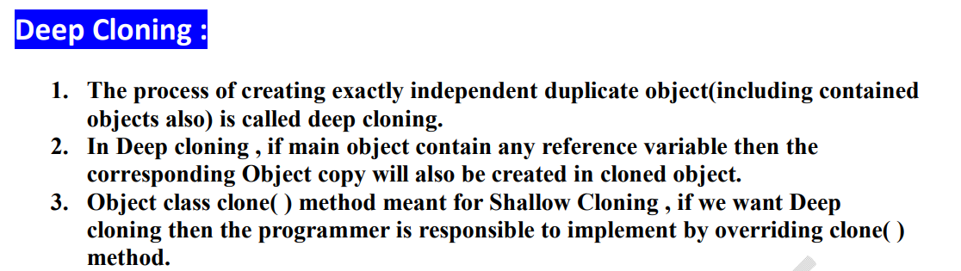

Slide 31
getClass() method :

Slide 32
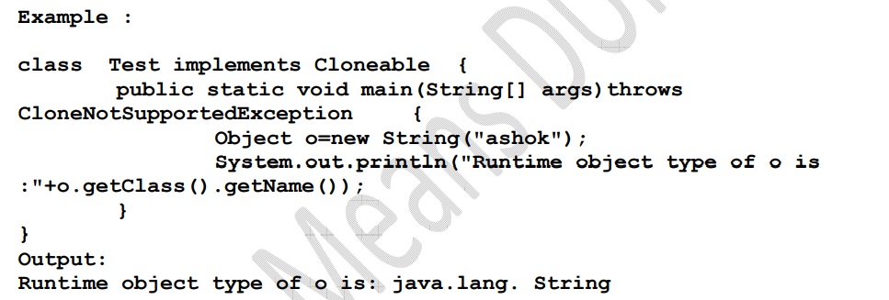

Slide 33
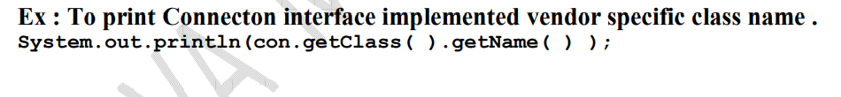

Slide 34
Finalize()

Slide 35
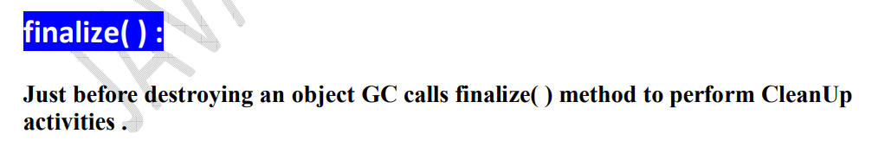

Slide 36
wait( ) , notify( ) , notifyAll( )

Slide 37
We can use these methods for inter thread communication

Slide 38
Why String is immutabiity?

Slide 39
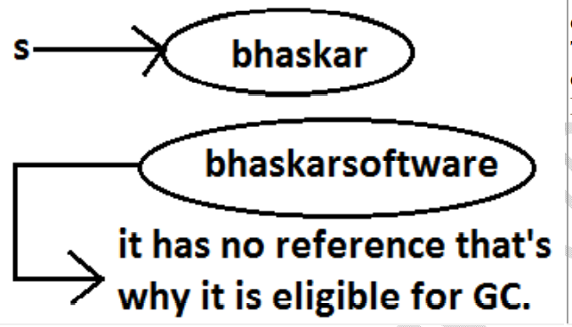

Slide 40
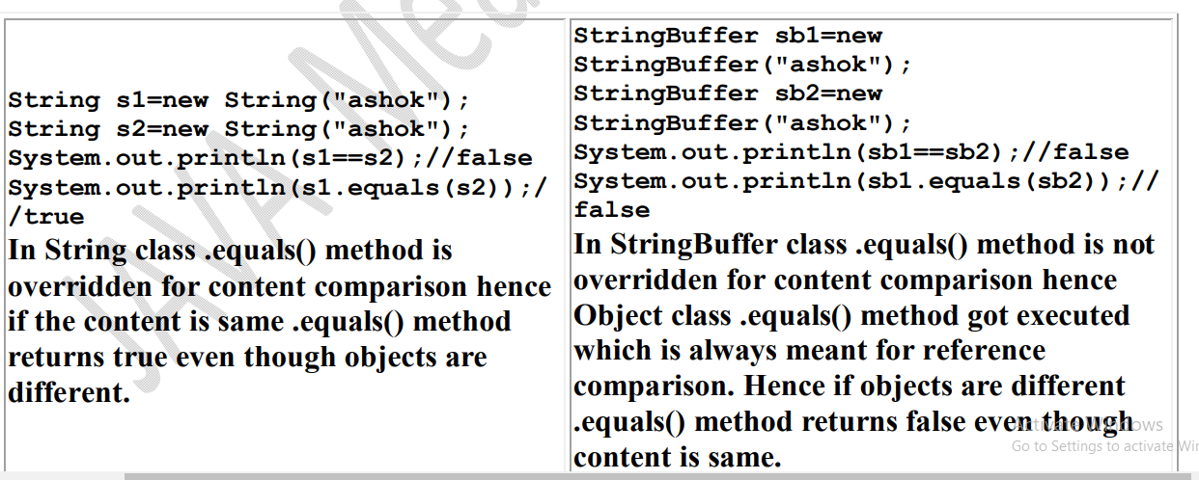

Slide 42
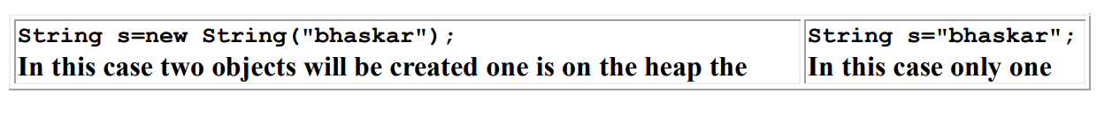

Slide 43
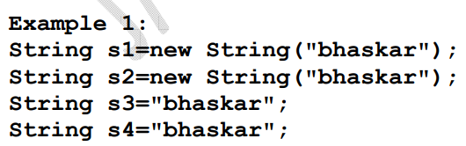
SCP And Heap ?

Slide 44
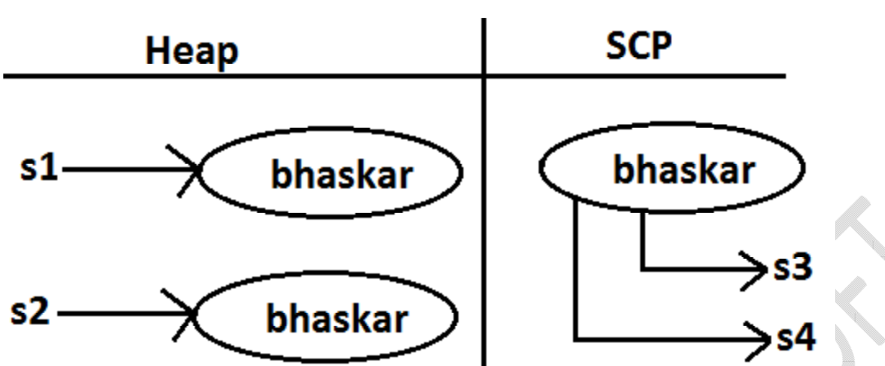

Slide 45
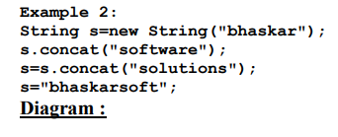

Slide 46
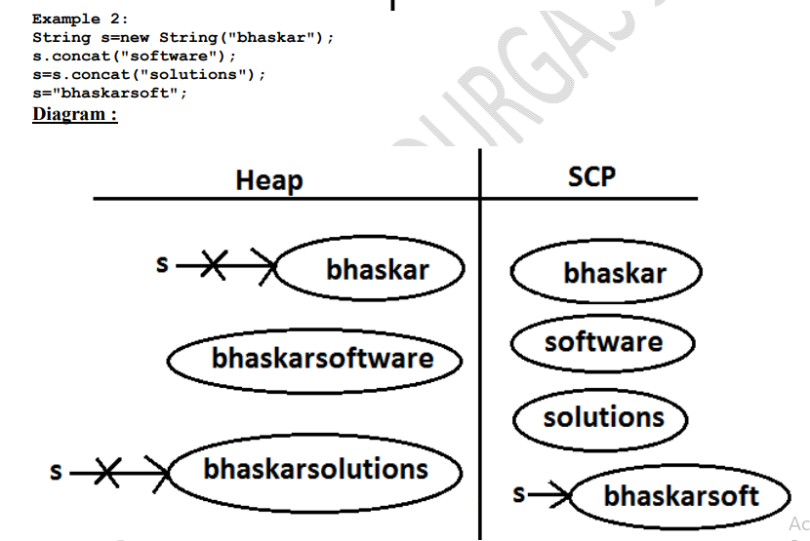

Slide 47
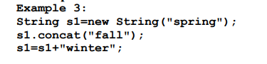
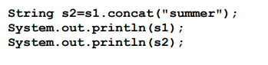

Slide 48
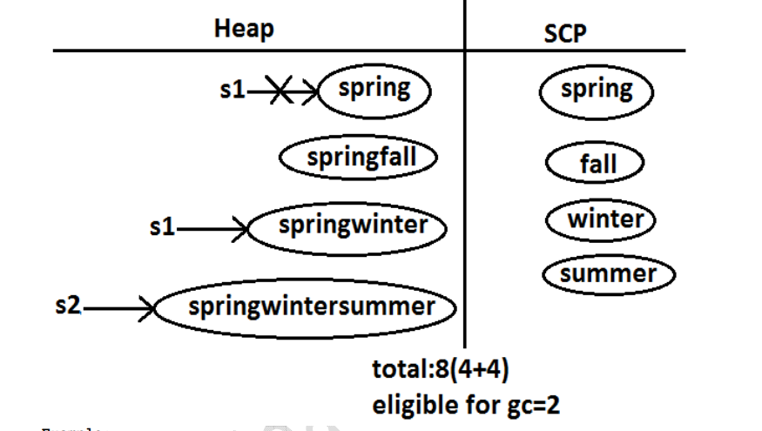

Slide 49
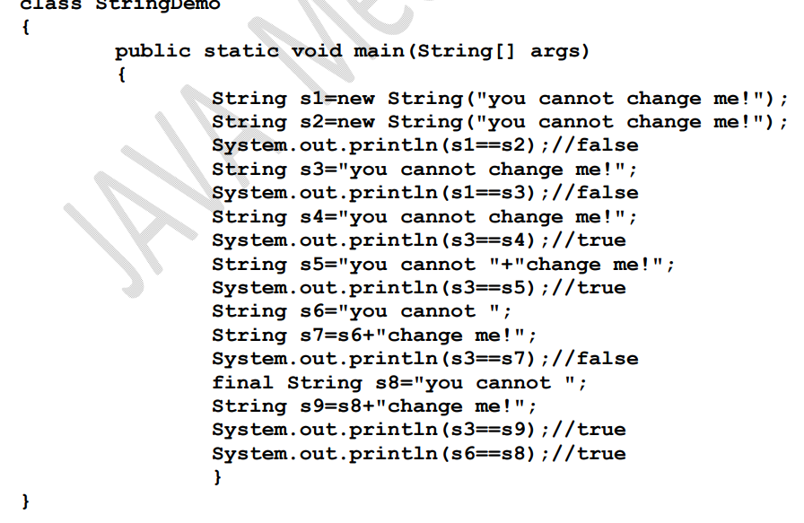

Slide 50
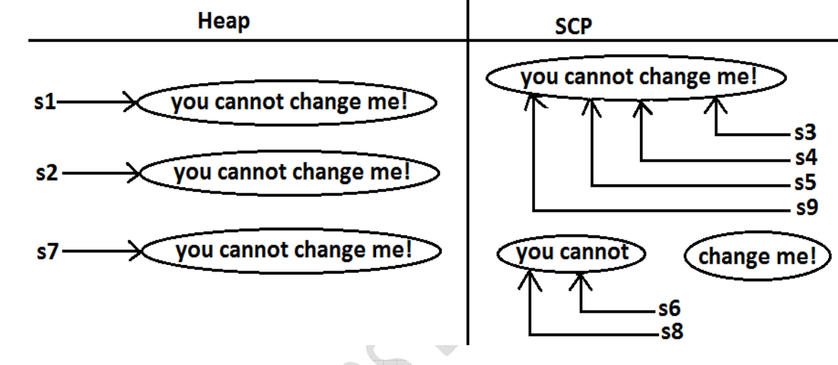

Slide 51
What is the main difference between String and StringBuilder?

Slide 52
What is the main difference between String and StringBuffer ?

Slide 53
Other than immutability and mutability is there any other difference between String and StringBuffer ?

Slide 54
What is the meaning of immutability and mutability?

Slide 55
Explain immutability and mutability with an example?

Slide 56
What is SCP?

Slide 57
What is the advantage of SCP?

Slide 58
What is the disadvantage of SCP?

Slide 59
Why String objects are immutable where as StringBuffer objects are mutable

Slide 60
What is the difference between final and immutability?

Slide 61
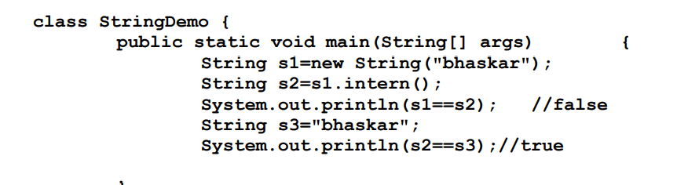

Slide 62
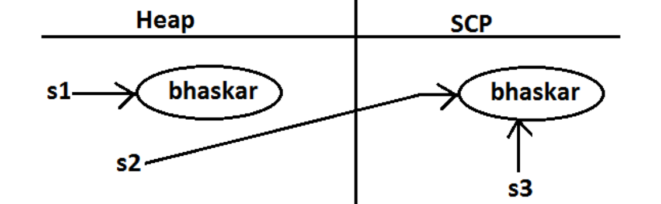

Slide 63
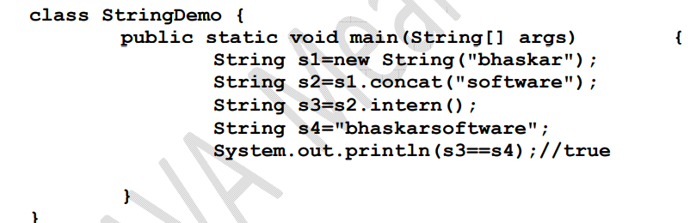

Slide 64
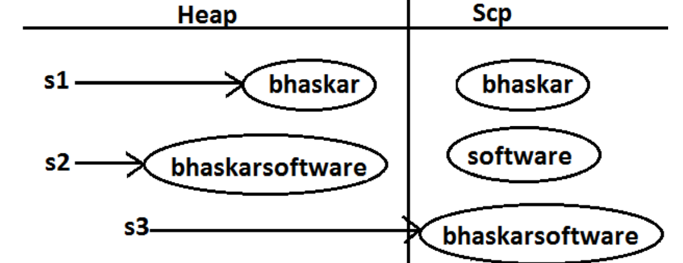

Slide 65
Final vs immutability :

Slide 66
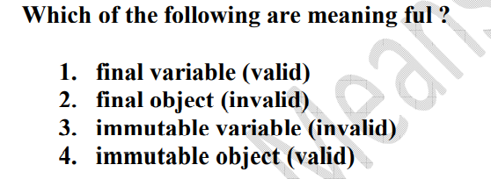
final modifier applicable for variables where as immutability concept applicable for objects

Slide 67
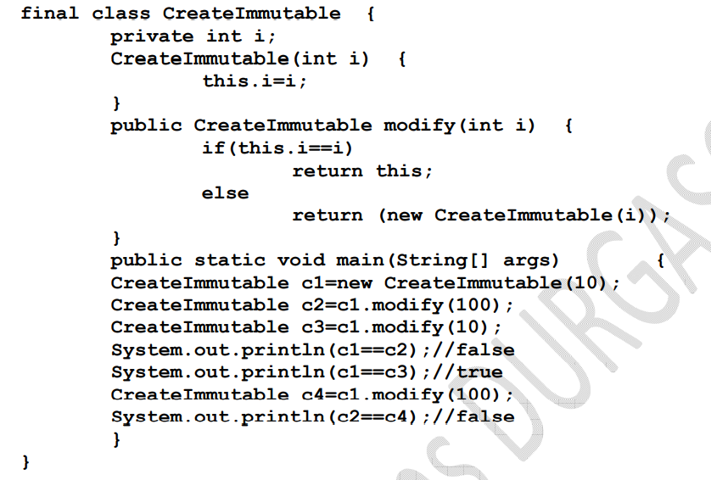

Slide 69
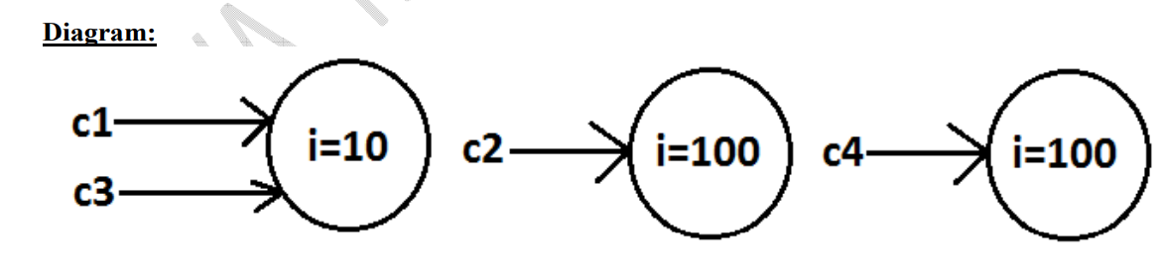

Slide 70
StringBuffer sb=new StringBuffer(); what is default size ?

Slide 71
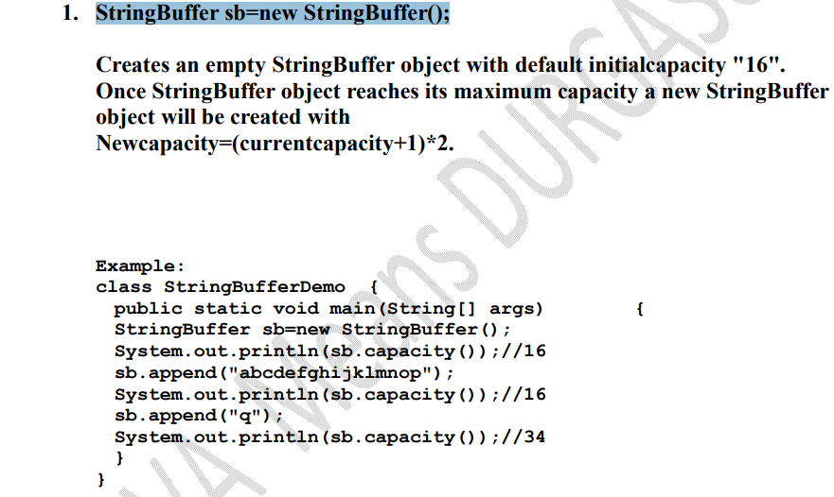

Slide 72
StringBuilder which version come ?

Slide 73
What is Method chaining?

Slide 74
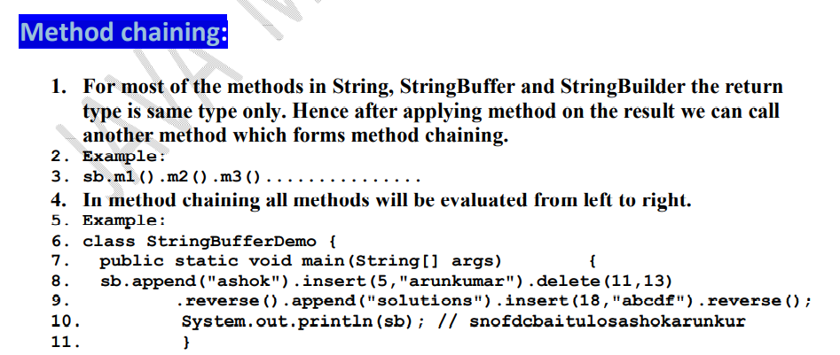

Slide 75
Wrapper classes ?

Slide 76
1. To wrap primitives into object form so that we can handle primitives also just like objects.
2. To define several utility functions which are required for the primitives.

Slide 77
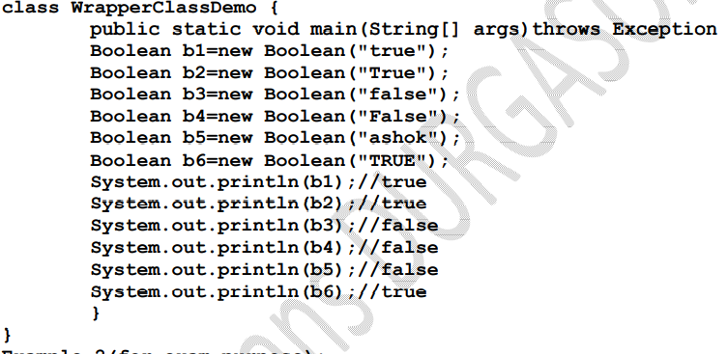

Slide 78
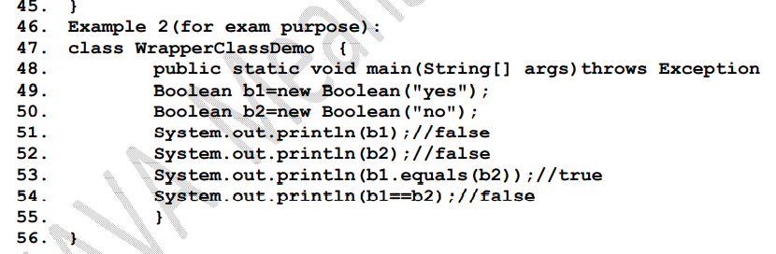

Slide 79
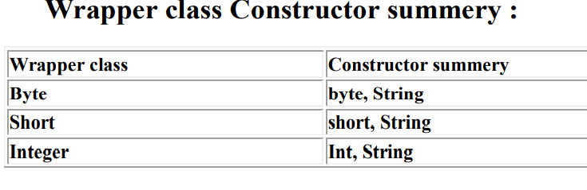
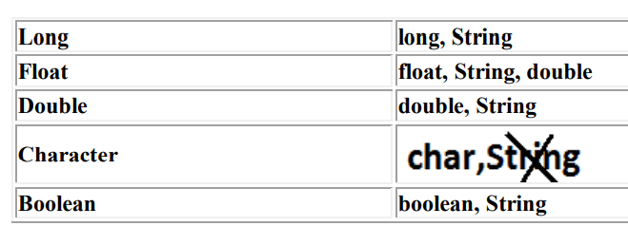

Slide 80
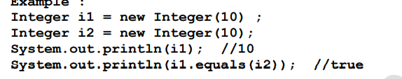

Slide 81
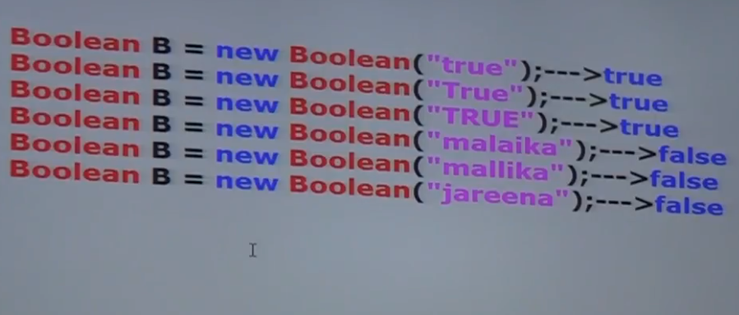

Slide 82
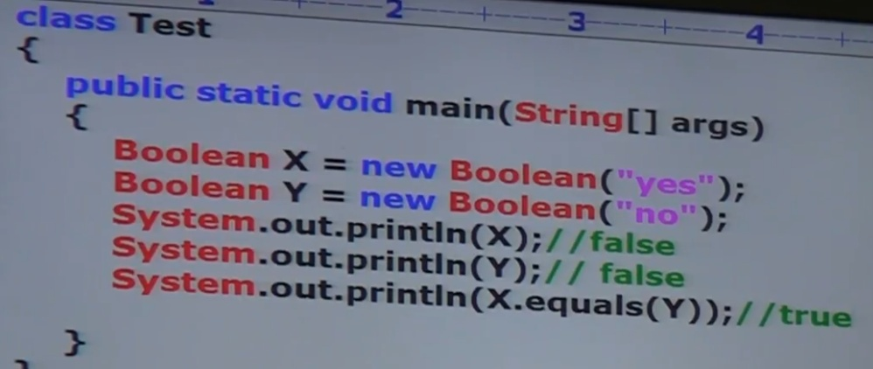

Slide 83
Utility methods:

Slide 84
1. valueOf() method.
2. XXXValue() method.
3. parseXxx() method.
4. toString() method.

Slide 85
valueOf() method :

Slide 86
valueOf() method :
We can use valueOf() method to create wrapper object for the given primitive or String this method is alternative to constructor.

Slide 87


Slide 88


Slide 89


Slide 90


Slide 91
xxxValue() method :

Slide 92
We can use xxxValue() methods to convert wrapper object to primitive

Slide 93


Slide 94
charValue() method:

Slide 95
Character class contains charValue() method to convert Character object to char primitive

Slide 96


Slide 97
booleanValue() method:

Slide 98


Slide 99
parseXxx() method :

Slide 100
We can use this method to convert String to corresponding primitive.

Slide 101
class WrapperClassDemo
{
public static void main(String[] args)
{
int i=Integer.parseInt("10");
boolean b=Boolean.parseBoolean("ashok"); double d=Double.parseDouble("10.5"); System.out.println(i);//10
System.out.println(b);//false System.out.println(d);//10.5
}
}

Slide 102
toString() method

Slide 103
We can use toString() method to convert wrapper object (or) primitive to String.

Slide 104
class WrapperClassDemo
{
public static void main(String[] args)
{
Integer i=Integer.valueOf("10"); System.out.println(i);//10 System.out.println(i.toString());//10
} }

Slide 105


Slide 106
Autoboxing and Autounboxing (1.5v)

Slide 107
Until 1.4 version we can't provide wrapper object in the place of primitive and primitive in the place of wrapper object all the required conversions should be performed explicitly by the programmer.

Slide 108


Slide 109
class AutoBoxingAndUnboxingDemo
{
public static void main(String[] args)
{
Boolean b=new Boolean(true);
if(b)
{
System.out.println("hello");
}
}
}
Output: hello

Slide 110
Output: hello

Slide 111


Slide 112
Autoboxing :

Slide 113


Slide 114
Autounboxing :

Slide 115


Slide 116


Slide 117


Slide 118


Slide 119


Slide 120


Slide 121


Slide 122


Slide 123


Slide 124


